Slide 1

Maximum-Weight Independent Set (MWIS)
CSCE500 – Algorithm Design & Analysis – Spring 2025
Presenter: Md Rakibuz Sultan

Slide 2
Independent Set
Definition: An independent set of a graph 𝐺=(𝑉,𝐸) is a set 𝑈⊆𝑉 of vertices such that there are no edges between any two vertices in 𝑈.
A subset of vertices in a graph such that no two vertices are adjacent.

Slide 3
Independent Set
Definition: An independent set of a graph 𝐺=(𝑉,𝐸) is a set 𝑈⊆𝑉 of vertices such that there are no edges between any two vertices in 𝑈.

Slide 4
Independent Set
Definition: An independent set of a graph 𝐺=(𝑉,𝐸) is a set 𝑈⊆𝑉 of vertices such that there are no edges between any two vertices in 𝑈.

Slide 5
MWIS for General Graph
5
15
A
E
F
2
2
B
D
C
20
10
{A,C,F} 5+10+2=17
{B,E,F} 2+15+2=19
{A,D} 5+20=25

Slide 6
MWIS for General Graph
5
15
A
E
F
2
2
B
D
C
20
10
Maximum weight independent set in the above graph: {A,D}

Slide 7
Not Considering General Graph

Slide 8
Not Considering General Graph

Slide 9
Not Considering General Graph

Slide 10
NP-hard
Non-deterministic Polynomial Time (NP): Problems in "NP" are ones where, if there is a solution, its correctness can be verified in polynomial time.
Why MWIS Is NP-hard?
Check all possible combinations of vertices to ensure no two are adjacent and that the weight is maximized.
For large graphs, the number of combinations grows exponentially, making the problem computationally infeasible to solve exactly in a reasonable amount of time.
Why Are Trees Special?
Can exploit their simpler structure (no cycles!) to solve MWIS efficiently using dynamic programming.

Slide 11
MWIS on Trees
Objective: To find the maximum-weight independent set for a tree where each node has an associated weight.

Slide 12
MWIS on Trees
The total number of Vertices in the independent Set is the sum of the number in each cluster. Ex: Here it could be 12
2
3
5
2
Disjoint

Slide 13
MWIS on Trees
The total number of Vertices in the independent Set is the sum of the number in each cluster. Ex: Here it could be 12
2
3
5
2
Disjoint

Slide 14
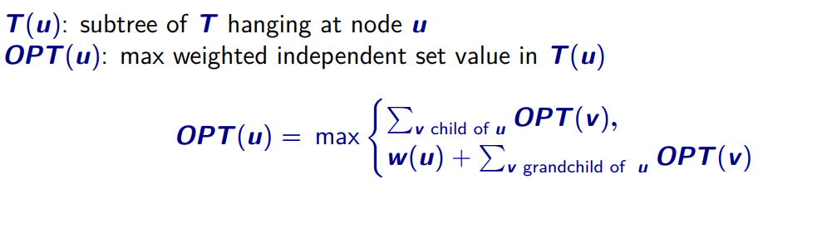
MWIS on Trees
2
3
5
2
Disjoint

Slide 15
Algorithm Design
Overview:
Use Dynamic Programming (DP) on trees.
Key Definitions:
dp[i][0]: Maximum weight excluding node i.
dp[i][1]: Maximum weight including node i.
Recurrence Relation:
𝑑𝑝[𝑖][0]=∑max(𝑑𝑝[𝑐ℎ𝑖𝑙𝑑][0],𝑑𝑝[𝑐ℎ𝑖𝑙𝑑][1])
𝑑𝑝[𝑖][1]=𝑤𝑒𝑖𝑔ℎ𝑡[𝑖]+∑𝑑𝑝[𝑐ℎ𝑖𝑙𝑑][0].

Slide 16
Pseudo Code
function MWIS(tree):
initialize DP arrays
function dfs(node):
for child in children[node]:
dfs(child)
update DP[node] using children’s DP values
dfs(root)
return max(dp[root][0], dp[root][1])
Time Complexity
[ Building the adjacency list and weights array: 𝑂(𝑛).
DFS traversal of the tree: 𝑂(𝑛). Total time complexity: 𝑂(𝑛) ]

Slide 17
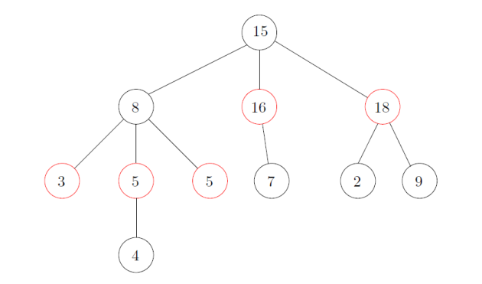
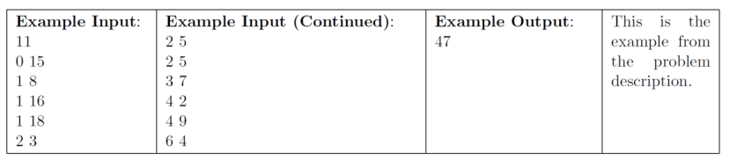
Problem Description
We assume that the nodes of the tree are [𝑛] = {1, 2, 3, … , 𝑛}. We root the tree at vertex 1, and for each vertex 𝑖 ∈ [2, 𝑛], the parent of 𝑖 is a vertex 𝑗 < 𝑖
The first line of input contains one integer 𝑛, the number of vertices in the tree.
The next n lines contain two integers each, where the 𝑖-th line contains two integers 𝑝𝑖 and 𝑤𝑖, where 𝑝𝑖 is the parent of 𝑖 and 𝑤𝑖 is the weight of 𝑖. We assume 𝑝1 = 0, which is useless. For all 𝑖 ∈ [2, 𝑛], we have 1 ≤ 𝑝𝑖 < 𝑖
Constraints:
• 1 ≤ 𝑛 ≤ 106.
• 1 ≤ 𝑛 ≤ 106 for every 𝑖 ∈ [𝑛].
• It is expected that your program will terminate in 10 seconds.

Slide 18
Given Example
Root 0
1
Node Parent Weight
Node 1: p=0 (root), w=15
Node 2: p=1, w=8
Node 3: p=1, w=16
Node 4: p=1, w=18
Node 5: p=2, w=3
Node 6: p=2, w=5
Node 7: p=2, w=5
Node 8: p=3, w=7
Node 9: p=4, w=2
Node 10: p=4, w=9
Node 11: p=6, w=4
15
2
8
3
16
4
18
5
3
6
5
7
5
8
7
9
2
10
9
11
4

Slide 19
Given Example
Root 0
1
Node Parent Weight
Node 1: p=0 (root), w=15
Node 2: p=1, w=8
Node 3: p=1, w=16
Node 4: p=1, w=18
Node 5: p=2, w=3
Node 6: p=2, w=5
Node 7: p=2, w=5
Node 8: p=3, w=7
Node 9: p=4, w=2
Node 10: p=4, w=9
Node 11: p=6, w=4
15
2
8
3
16
4
18
5
3
6
5
7
5
8
7
9
2
10
9
11
4
3+5+5+15+7+2+9=46

Slide 20
Given Example
Root 0
1
Node Parent Weight
Node 1: p=0 (root), w=15
Node 2: p=1, w=8
Node 3: p=1, w=16
Node 4: p=1, w=18
Node 5: p=2, w=3
Node 6: p=2, w=5
Node 7: p=2, w=5
Node 8: p=3, w=7
Node 9: p=4, w=2
Node 10: p=4, w=9
Node 11: p=6, w=4
15
2
8
3
16
4
18
5
3
6
5
7
5
8
7
9
2
10
9
11
4
3+5+5+16+18=47

Slide 21
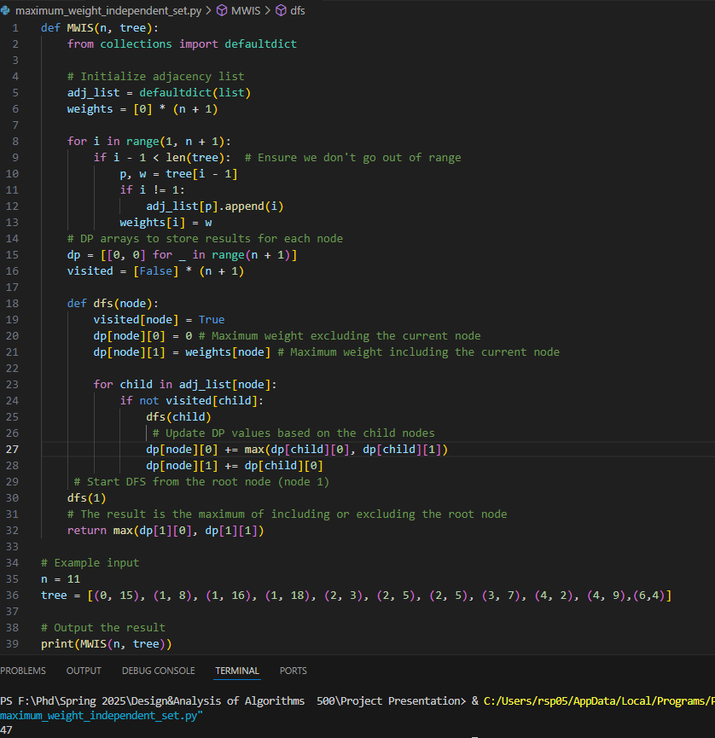
Implementation
Time Complexity:
Each node and edge is processed exactly once, so O(n).
Space Complexity:
Use of adjacency list and DP arrays leads to O(n)space.
https://github.com/Rakibuz/CSCE500-Algorithm-Design-Analysis-Spring25

Slide 22
Analyzing Complexity
Time Complexity Analysis
DFS Traversal:
DFS on a general graph is O(V + E)
Each node is visited exactly once (no cycles in a tree).
For each node, we process its children (edges). Since there are n-1 edges in total, the total work is O(n).
O(V + E) becomes O(n + (n - 1)) → O(n)
DP Operations:
For each node, we perform constant-time operations (e.g., max on child values). This adds no extra asymptotic cost. Thus, the total time is O(n).

Slide 23
Analyzing Complexity
Space Complexity Analysis
Adjacency List: Stores n nodes and n-1 edges → O(n).
DP Arrays: Two entries per node → O(n).
Visited Array: O(n).
Recursion Stack: Worst-case depth is O(n) (e.g., a skewed tree like a linked list).
Total space complexity is O(n).

Slide 24
Algorithm's execution

Slide 25
Real-world use cases for MWIS
Network optimization: Selecting non-adjacent network nodes for load balancing.
Scheduling: Assigning non-conflicting tasks or resources.
Resource allocation: Maximizing non-overlapping allocations based on priorities.

Slide 26


Slide 27


